Slide 1
Memory Management in Java

Slide 2
Objectives
Study Stack, Static Heap, Dynamic Heap
Allocation and Deallocation
Garbage Collection

Slide 3
Memory Management in Java
Review: In C, 4 basic regions: Data segment (for global data), code segment (for statements), stack (for local data of functions when they are called), heap (for dynamic data). C/C++ programmers must explicitly manage the heap of a program.
How Java heap is managed? (Refer to: http://docs.oracle.com/javase/specs/)
JVM supports the garbage collector in order to free Java programmers from explicitly managing heap
Java heap is managed by 2 lists: Free block list, Allocated block list
Initial, free block list is all the heap
After very much times for allocating and de-allocating memory, fragmented and free blocks are not contiguous

Slide 4
Memory Management in Java
How are data allocated in heap?
Way: First fit
If there is no blank block is fit, Java memory manager must compact memory in order to create more larger free block
Heap structure in Java
Static heap contains class declarations → Invariable, garbage collection is not needed
Dynamic heap is divided into two sections: The first contains objects and the second contains relations between object and appropriate method in static heap. When an object is not used (garbage), it’s memory can be de-allocated.
When an object is created, a field for reference to the class declaration is automatically added
The next slide will depict it..

Slide 5
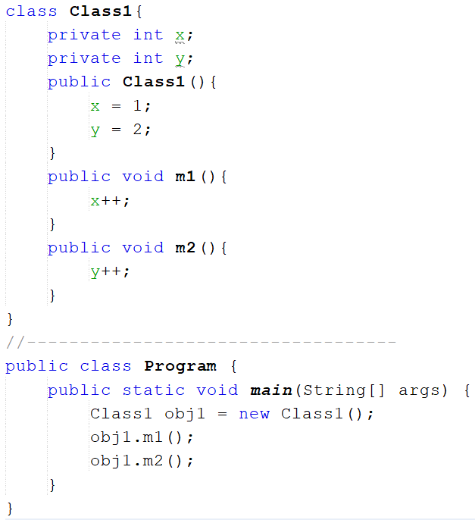

Slide 6
Memory Management in Java
Class1 Definition
Constants/fields
Method table
(m1,,add1)
(m2,,add2)
m1
m2
Dynamic heap Section 2
( Entry: 2 references)
(10000, m1) → obj1.m1()
(8000, m4) → obj2.m4()
Dynamic heap
Section 1
(Garbage collection is applied)
1000
Fields
obj1:10000
(2)
500
Fields
obj2:8000
(4)
(3)
(1)
1000
Class2 definition
Constants/fields
Method table
(m3,,add3)
(m4,,add4)
m3
m4
Dynamic heap
Section 2 Relations object-method
(5) Code of m1() executes
500
Static heap

Slide 7
Garbage Collection
Most modern languages permit you to allocate data storage during a program run. In Java, this is done directly when you create an object with the new operation and indirectly when you call a method that has local variables or arguments.
Local data of a method include: return data, parameters, variables are declared in the body of the method.
Local methods are allocated space on the stack and are discarded when the method exits, but objects are allocated space on the heap and have a longer lifetime.

Slide 8
Garbage Collection
In Java, you never explicitly free the memory that are allocated; instead, Java provides automatic garbage collection.
The runtime system keeps track of the memory that is allocated and is able to determine whether that memory is still useable.
Garbage collector has the lowest priority. It runs only when the system heap becomes exhausted.
A data is treated as garbage when it is out of it’s scope or an object is assigned to null.

Slide 9
Garbage Collection
Object obj1 = new Object();
int x= 5;
if (x<10) {
Object obj2= new Object();
int y=3;
………
}
int t=7;
obj1 = null;
t*=8;
……
Scope of a variable begins at the line where it is declared and ends at the closing bracket of the block containing it
obj2, y are out of scope ( they are no longer used)
obj1= null → Memory allocated to obj1 is no longer used

Slide 10
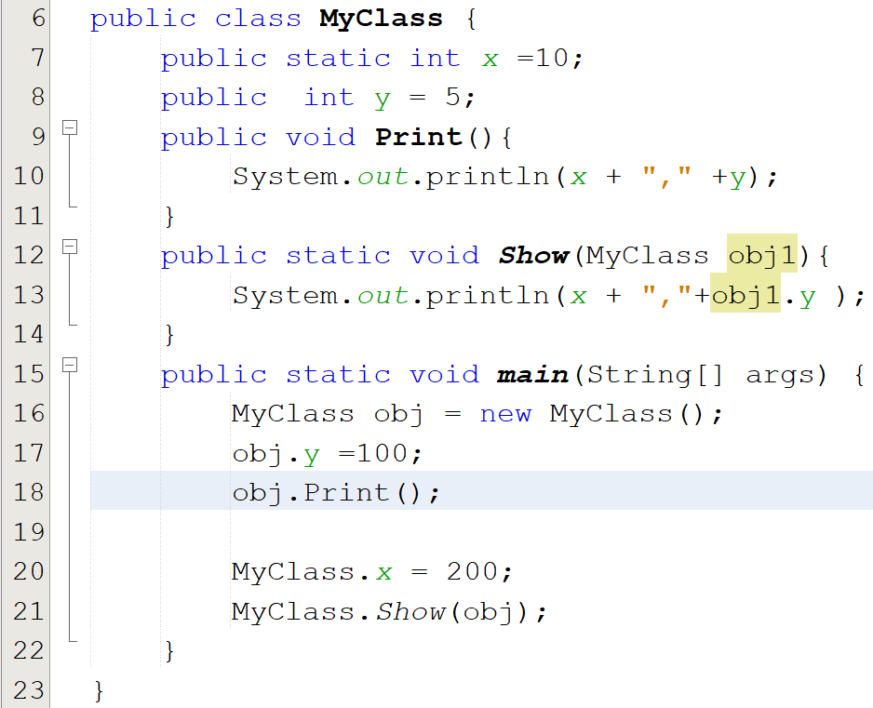

Slide 11
Garbage Collection
When does garbage collector execute?
Garbage collector has the lowest priority. So, it runs only when program’s memory is exhausted.
It is called by JVM only. We can not activate it.

